Slide 1

Social Network and
Social Media Analysis
Wang Daling, Feng Shi
College of Computer Science and Engineering

Slide 2





Course Outline
Introduction
Basic Knowledge
Representation Learning
Sentiment and Emotion Analysis
Search and Recommendation

Slide 3
Representation Learning
Word Embedding

Slide 4
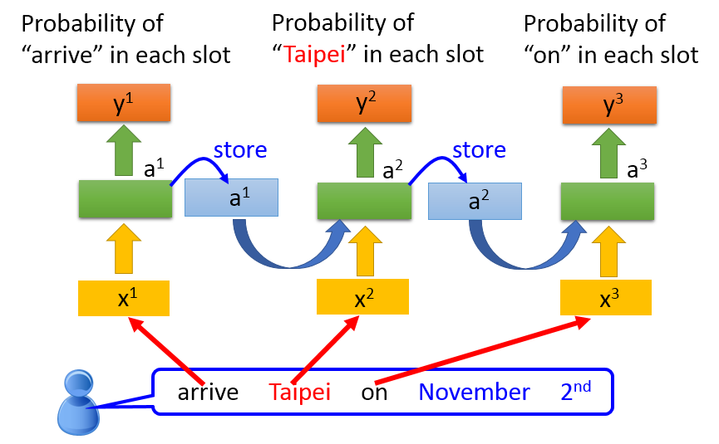
The Input of Neural Network
Reflect the meaning of the word
Can be calculated
Notes:
The input of the word representation should reflect the meaning of the word.
Can be calculated.

Slide 5
How to give word a new representation?
Word Embedding
Also known as
Word Vector
Distributed Representation

Slide 6
How do we represent the meaning of a word?
Definition: Meaning (Webster dictionary)
the idea that is represented by a word, phrase, etc.
the idea that a person wants to express by using words, signs, etc.
the idea that is expressed in a work of writing, art, etc.

Slide 7
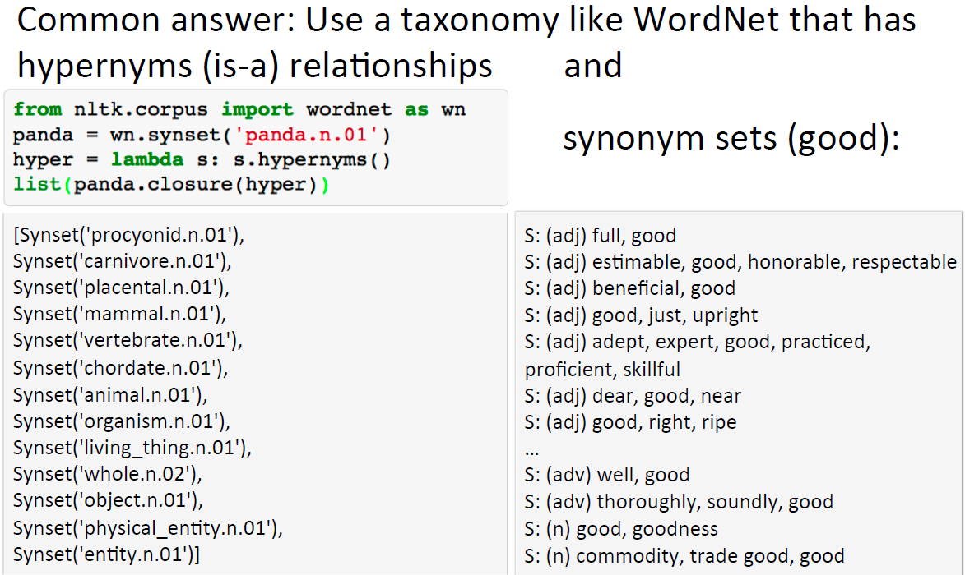
How to represent meaning in a computer?

Slide 8
Problems with this discrete representation
Great as resource but missing nuances, e.g. synonyms:
adept, expert, good, practiced, proficient, skillful?
Missing new words (impossible to keep up to data): wicked, badass, nifty, crack, ace, wizard, genius, ninjia
Subjective
Requires human labor to create and adapt
Hard to compute accurate word similarity →
蓝星人
两脚兽
铲屎官
猫奴
Notes:
HowNet是中国的语义本体
Labor-intensive

Slide 9
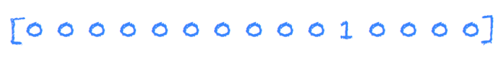
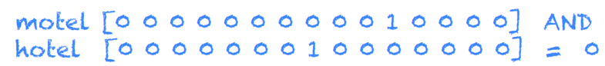
Problems with this discrete representation
The vast majority of rule-based and statistical NLP word regards words as atomic symbols:
In vector space terms, this is a vector with one 1 and a lot of zeroes
Dimensionality 20K (speech); 50K (PTB); 500K (big vocab); 13M (Google 1T)
We call this a “one-hot” representation. Its problem:
Notes:
Words are symbols, independent to each other! Each word is represented as an axis in a 1000-dimensional space. Distance between words has no meaning.

Slide 10
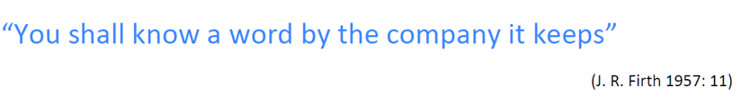
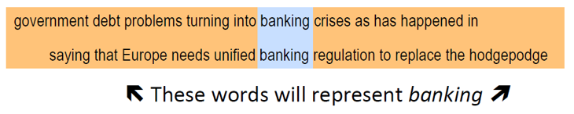
Distributional similarity based representations
You can get a lot of value by representing a word by means of its neighbors
One of the most successful ideas of modern statistical NLP

Slide 11
How to make neighbors represent words?
Answer: With a cooccurrence matrix X
2 options: full document vs. windows
Word-document cooccurrence matrix will give general topics (all sports terms will have similar entries) leading to “Latent Semantic Analysis”
Window allows us to capture both syntactic (POS) and semantic information →

Slide 12
Window based cooccurrence matrix
Window length L (more common: 5-10)
Symmetric (irrelevant whether left or right context)
Example corpus:
I like deep learning.
I like NLP.
I enjoy flying.

Slide 13
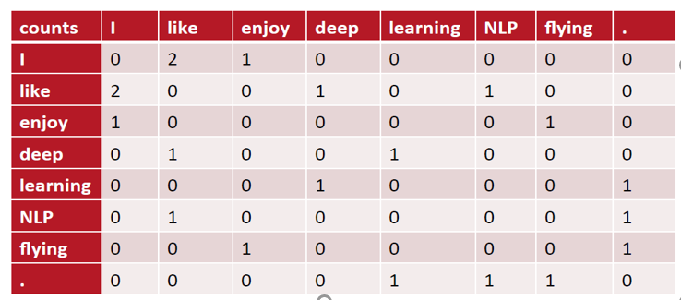
Window based cooccurrence matrix
Example corpus:
I like deep learning.
I like NLP.
I enjoy flying.

Slide 14
Problems with simple cooccurrence vectors
Increase in size with vocabulary
Very high dimensional: require a lot of storage
Subsequent classification models have sparsity issues
→Models are less robust

Slide 15
Solution: Low dimensional vectors
Idea: store “most” of the important information in a fixed, small number of dimensions: a dense vector
Usually around 25-1000 dimensions
How to reduce the dimensionality?

Slide 16
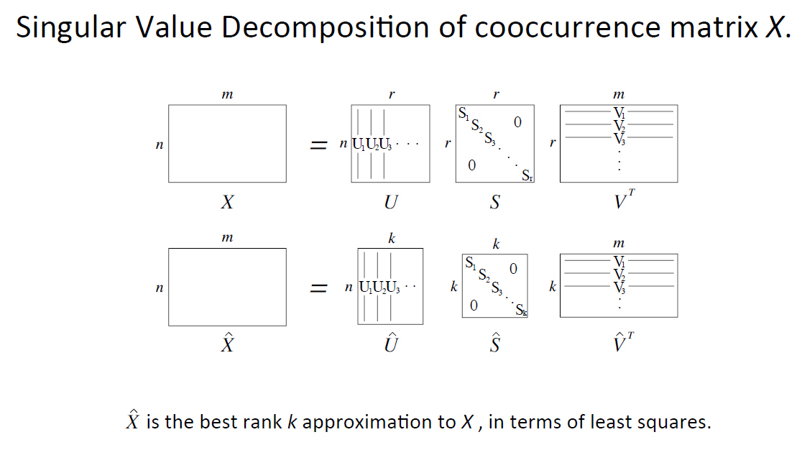
Method 1: Dimensionality Reduction on X

Slide 17
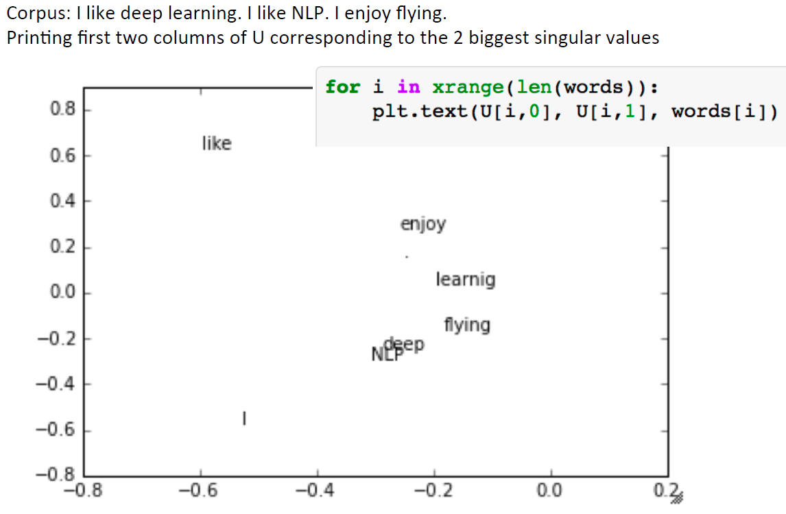
Simple SVD word vectors in Python

Slide 18
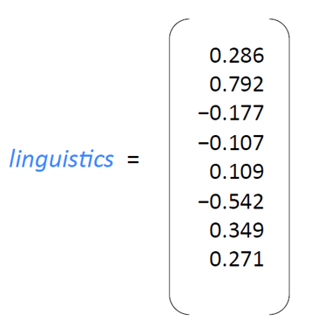
Word meaning is defined in terms of vectors
In all subsequent models, including deep learning models, a word is represented as a dense vector
Notes:
Distributed representation 多个非零分量

Slide 19
Word meaning is defined in terms of vectors
Embed each word as a point in a space of lower dimensions (say 200)
E.g., “apple” could be represented as : [0.4, 0.1, 0.5, 0.3, . . . 0.1, 0.2] and “computer” could be represented as : [0.1, 0.1, 0.1, 0.3, . . . 0.3, 0.2]
By embedding so large a number of points (words) in a low-dimensional space, the points are no more independent to each other.
The values of points in a particular dimension are the projection of those points onto the corresponding axis.
Words are not only symbols but relevant in certain ways. We may capture their relevance by properly positioning them in the space.

Slide 20
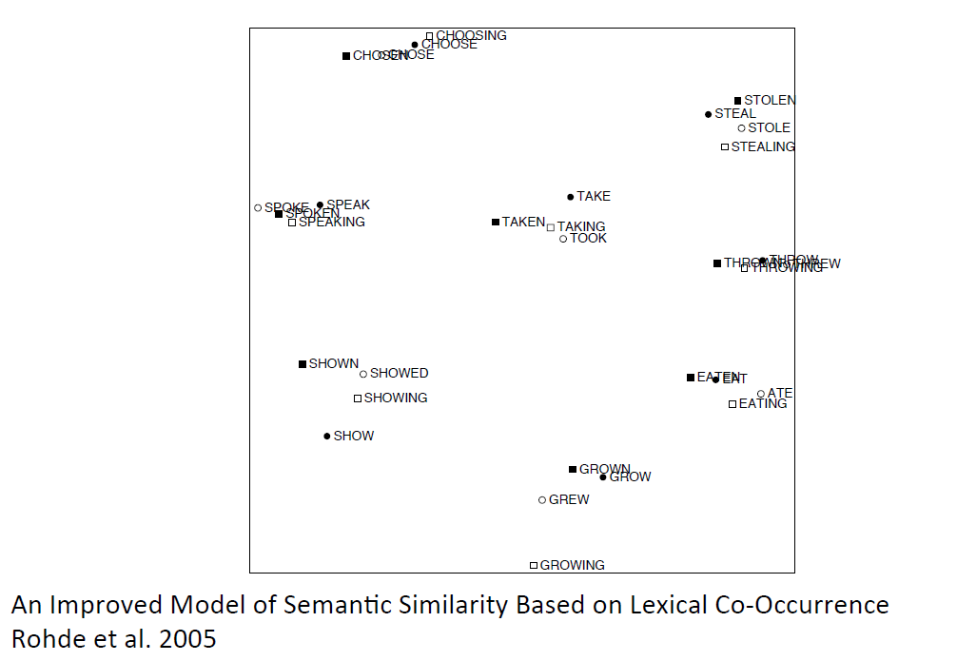
Interesting semantic patters emerge in the vectors

Slide 21
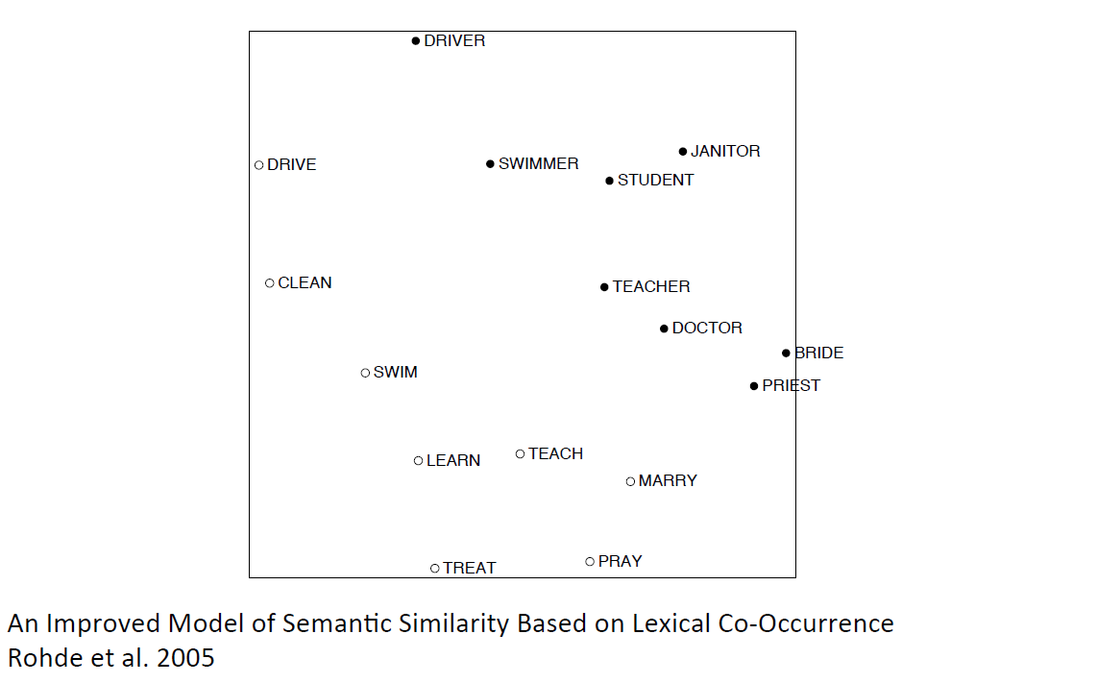
Interesting semantic patters emerge in the vectors

Slide 22
Problems with SVD
Computational cost scales quadratically for n × m matrix: O(mn²) flops (when n<m)
→Bad for millions of words or documents
Hard to incorporate new words or documents
Different learning regime than other DL models

Slide 23
Idea: Directly learn low-dimensional word vectors--Neural Probabilistic Language Model
Learning representations by back-propagating errors. (Rumelhart et al., 1986)
A neural probabilistic language model (Bengio et al., 2003)
NLP from Scratch (Collobert & Weston, 2008)
A famous and even simpler model:
word2vec (Mikolov et al. 2013)→intro now

Slide 24
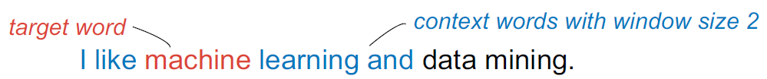
Main idea of word2vec
Instead of capturing co-occurrence counts directly, predict surrounding words of every word
Faster and can easily incorporate a new sentence/document or add a word to the vocabulary
Very simple neural network (NN) models to learn word vectors by capturing the co-occurrence of words in documents
Problem Definition
Given a textual dataset D, a dimension d of the word vectors, a window size c, learn a representation (i.e., a vector) of length d for each word in D.
word2vec explores the co-occurrence of a (target) word and its context words, i.e., words appearing nearby in sentences
Notes:
Word2vec的写法问题

Slide 25
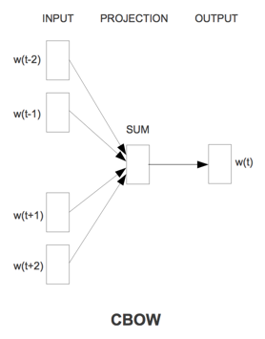
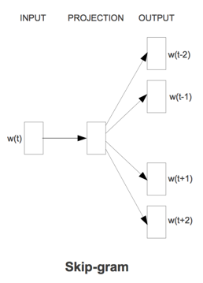
Main idea of word2vec
Continuous Bag of Words (CBOW): the appearance of a target word depends on its context words
Skip-Gram: the appearance of context words depend on the target word

Slide 26
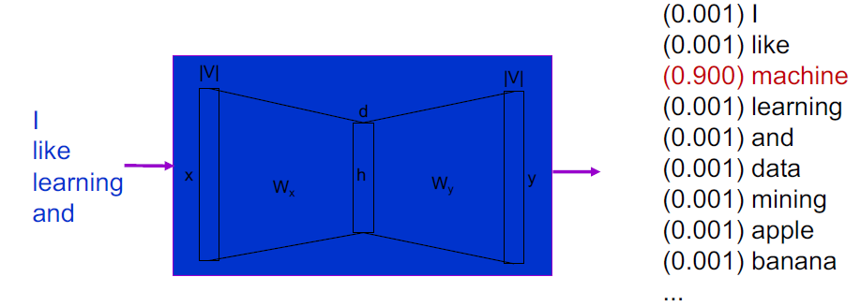
Word2vec - CBOW
CBOW takes the AVERAGE of all context word vectors to predict the probabilities for each word to be the TARGET
CBOW transforms the goal into a multi-class classification problem

Slide 27
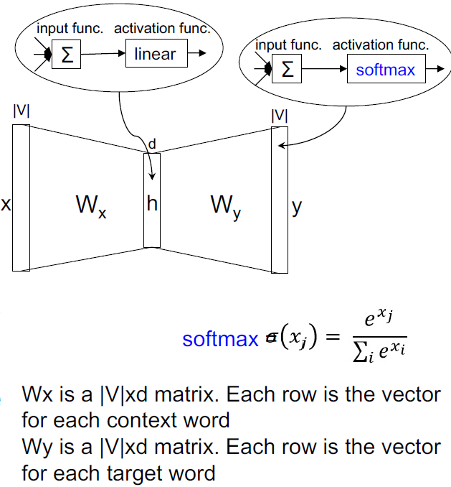
Word2vec – CBOW
It is a shallow, fully connected NN model with one hidden layer
Input x
A vector of context words
Output y
Predicted probability for each target word
softmax(): to normalize the output vector such that the summary of its values is 1

Slide 28
Word2vec – CBOW – Training
The learning process
1. Training data generation
2. NN model training
After the training, it returns output layer parameter W_{y} as the representation set of words
Given a dataset D, preparing a training set T for each word as follows.
Consider a vocabulary of 26 distinct words, A~Z.
For a document, A A B C D D …, window size = 2
1. target: A, context: AB
2. target: A, context: ABC
3. target: B, context: AACD
4. target: C, context: ABDD
5. …

Slide 29
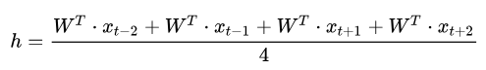
Word2vec – Model Training
Given a training set T, the model is trained by stochastic gradient descent (SGD).
For a training data, windows size=2
CBOW predicts
Input layer: x_{t-2}, x_{t-1}, x_{t+1}, x_{t+2} (V×1)
Input layer weight parameter W_{x} (V×d)
Hidden layer h (d×1)
Output layer weight parameter W_{y} (d×V)
Output layer y (V×1)
y=softmax((W_{y})^{T} ·h)

Slide 30
CBOW – Parameter Update
The goal of training is to update model parameters in order to maximize the probability of the target word, and minimize the probability of NON-target words.
Each word has two roles:
A target word or a context word of another target word
CBOW (and all other models of word2vec) aims to
Maximize the inner product of vec(target) and vec(context).
i.e., to move vec(target) and vec(context) closer
Minimize the inner product of vec(non-target) and vec(context).
i.e., to move vec(non-target) and vec(context) away
Two target words’ vectors are close to each other, i.e., similar or relevant, if they have similar contexts.
y=softmax((W_{y})^{T} ·h)

Slide 31
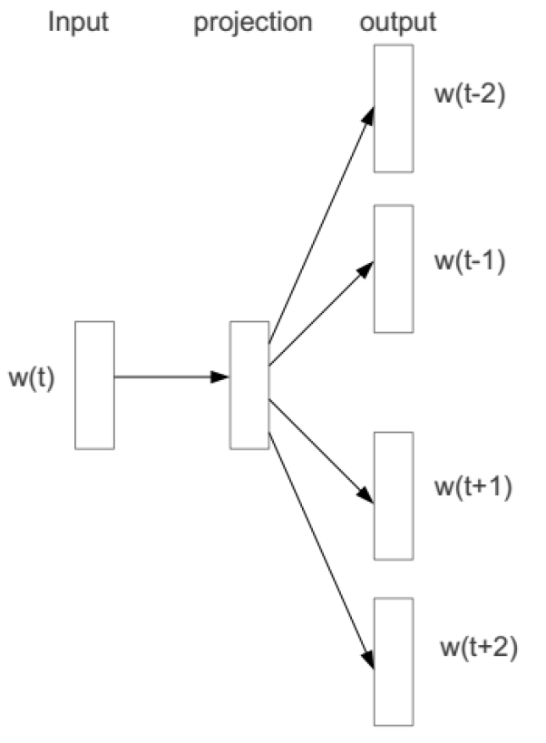
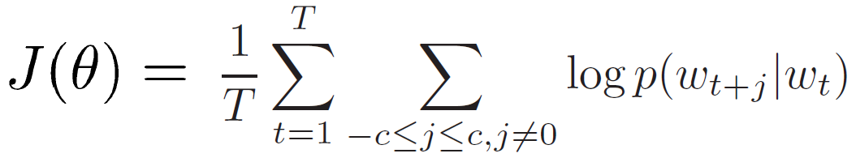
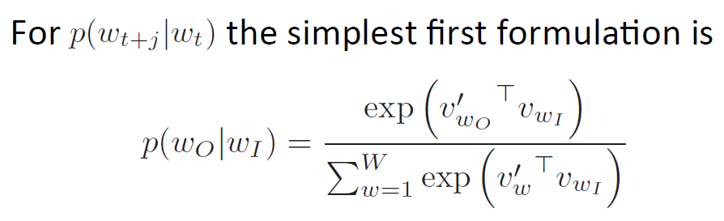
Main idea of word2vec – SkipGram
Objective function: Maximize the log probability of any context word given the current center word:

Slide 32
Main idea of word2vec

Slide 33
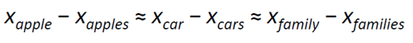
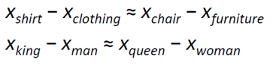
Linear relationships in word2vec
These representations are very good at encoding dimensions of similarity！
Analogies testing dimensions of similarity can be solved quite well just by doing vector subtraction in the embedding space
Syntactically
Words with multiple meanings (polynonyms) are brought close to each other
Similarly for verb and adjective morphological forms
Semantically (Semeval 2012 task 2), difference between some words’ vectors are similar
Notes:
Analogies testing类比测试

Slide 34
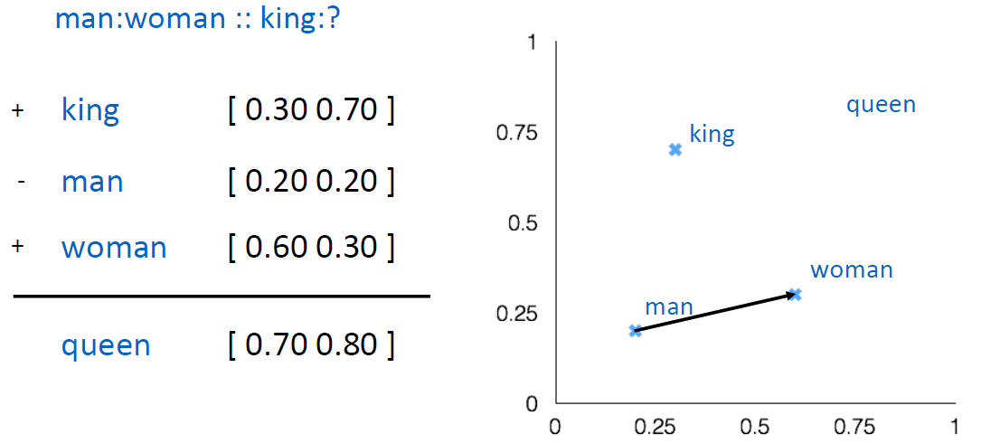
Linear relationships in word2vec

Slide 35
Word2Vec – Technical Issues
Although word2vec models are simple, it is too slow to train using very large-scale real-world datasets
Each word has two roles:
A target word or a context word of another target word
It can be seen as 26 distinct sub-training data
y = [0.5, 0, 0.25, 0.25, 0, 0, 0, …, 0]
many of those sub-training data are negative (i.e., label 0)
Imbalanced issue may hurt the performance of the trained model.
Many rows in W_{y} may not need to be updated

Slide 36
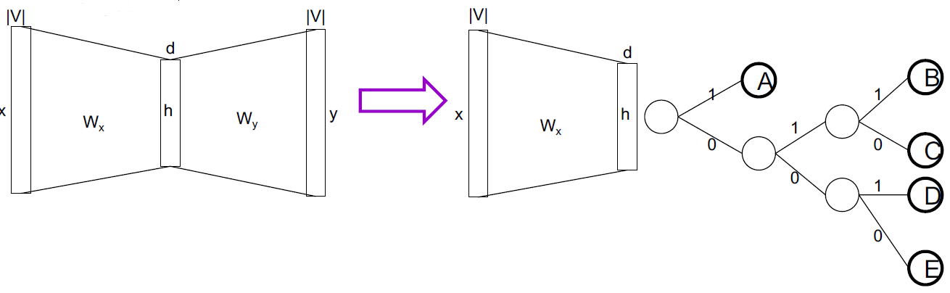
Word2Vec – Hierarchical Softmax
To reduce updates of whole W_{y} for a training data, word2vec transforms the original NN model from a multi-class classifier to a hierarchical classifier.
A binary tree where each internal node is a binary classifier
i.e., h is d-dim. v and h predict the context by sigmoid(h⋅v)
Each leaf node represents a word. There are |V| leaf nodes.

Slide 37
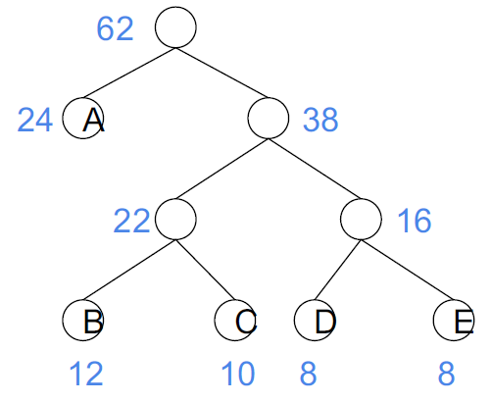
Hierarchical Softmax
Word2Vec uses Huffman tree.
Each word has two roles:
In a Huffman tree, higher frequent words have shorter paths to the root.
Thus, it further reduces the training time because the training time of higher frequent target words is shorter.
Notes:
The Huffman tree may not be the best for hierarchical classifiers
In a hierarchical classifier, classes in the same subtree should be relevant.
A Huffman tree of words only captures the frequency but not the semantics of words

Slide 38
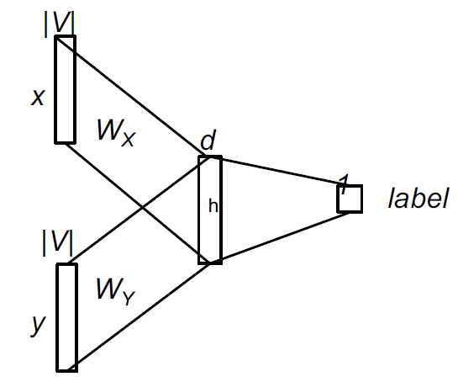
Word2Vec – Negative Sampling
To handle the imbalance issue and to reduce the training time.
Reduce the number of negative data by random sampling.
Transform the multiple classifier in the original NN model into one binary classifier (using Sigmoid)

Slide 39
Word2Vec – Technical Issues
Consider a vocabulary of 26 distinct words, A~Z.
For a document, A A B C D D …, window size = 2
Positive data sample (target, context): (A, AB), (A, ABC),(B, AACD)…
For each positive sample, generate k negative samples
e.g., for (B, AACD) where k=3, generate (X, AACD), (Y,AACD), (Z, AACD)
For each sample, transform as (x, y, label)
(B, AACD) → (x: [0, 1, 0, ...], y: [0.5, 0, 0.25, 0.25, ...],label:1);
(X, AACD) → (x: [0, …, 0, 1, 0, 0], y: [0.5, 0, 0.25,0.25, ...], label:0);
…

Slide 40
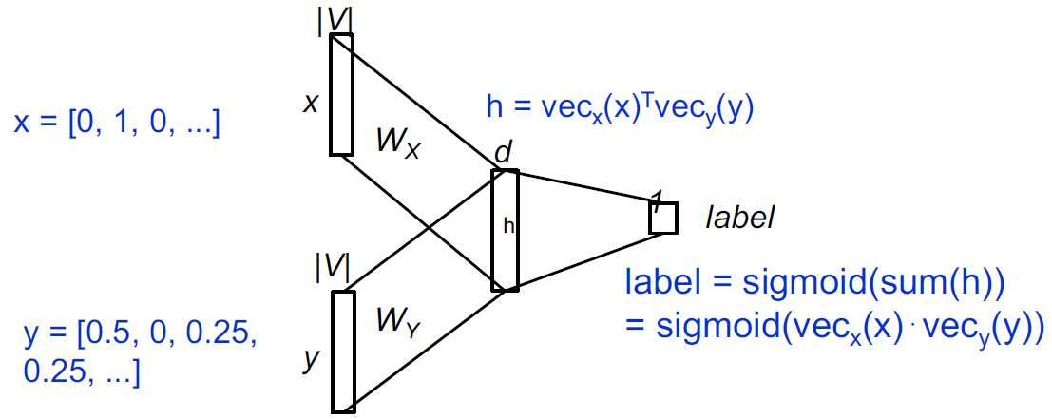
Word2Vec – Technical Issues
The model is trained by SGD to maximize:
sigmoid(vecx(x)⋅vecy(y)) if it is a positive sample
1 - sigmoid(vecx(x)⋅vecy(y)) if it is a negative sample
E.g., (B, AACD) → (x: [0, 1, 0, ...], y: [0.5, 0, 0.25,0.25, ...], label:1)

Slide 41
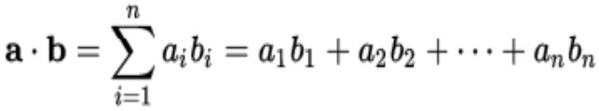
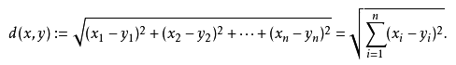
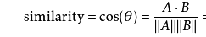
Distance functions in Word2Vec
How to define the similarity of two word vectors?
E.g., Euclidean distance, cosine, …
word2vec uses the inner product of two vectors.
E.g., [1, 2, 3]⋅[10, 100, 1000] =1*10+2*100+3*1000 =3210
Why to use inner product?
inner product seems to maintain both characteristics of Euclidean distance and cosine
The inner product of two vectors is large, when the two vectors are close and the angle of the two vectors is small.
A target word is close (similar) to the context words as the training aims to maximize their inner product.

Slide 42
Word Embedding Tools (NN based)
Word2vec
Glove
fastText
Notes:
基于词的固定表征

Slide 43
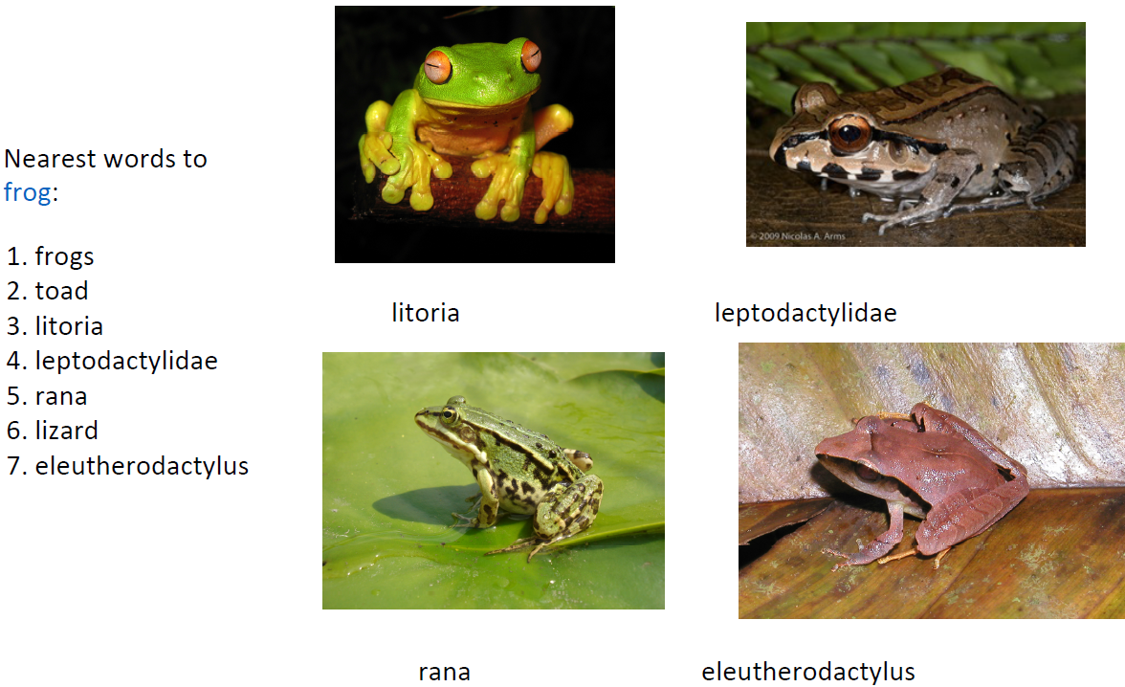
GloVe: Global Vectors for Word Representation (EMNLP 2014)

Slide 44
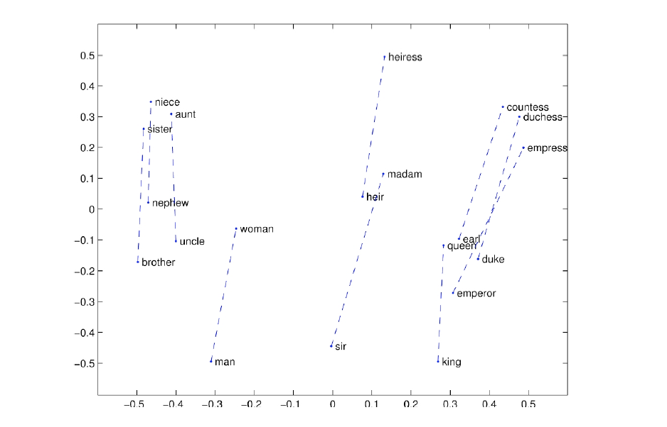
Glove Visualizations
Glove: Global Vectors for Word Representation (EMNLP 2014)

Slide 45
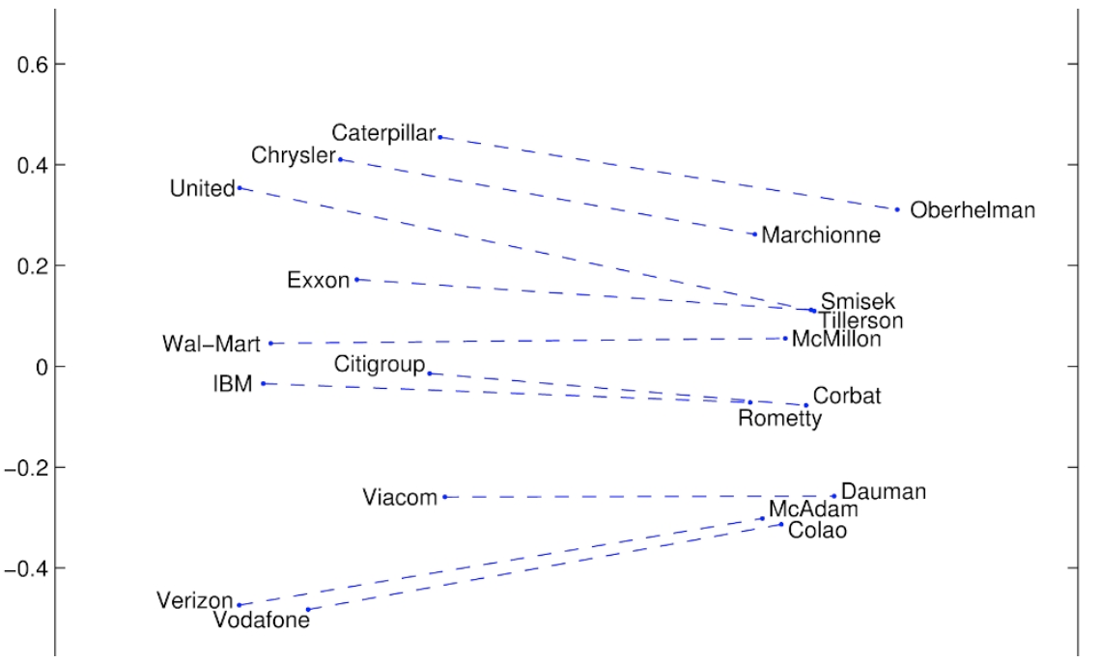
Glove Visualizations: Company‐CEO
Glove: Global Vectors for Word Representation (EMNLP 2014)

Slide 46
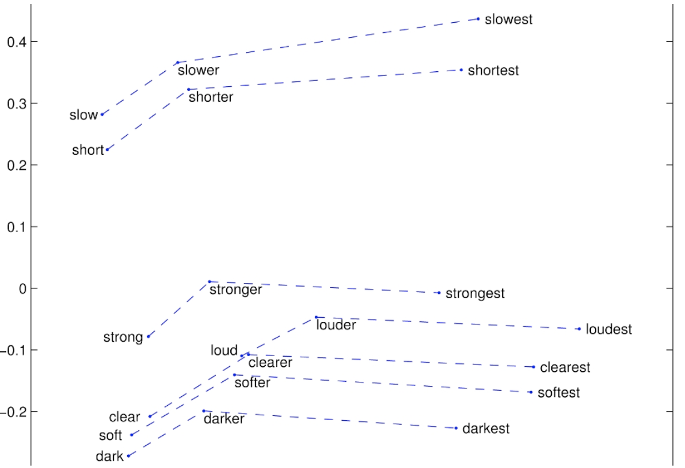
Glove Visualizations: Superlatives
Glove: Global Vectors for Word Representation (EMNLP 2014)

Slide 47
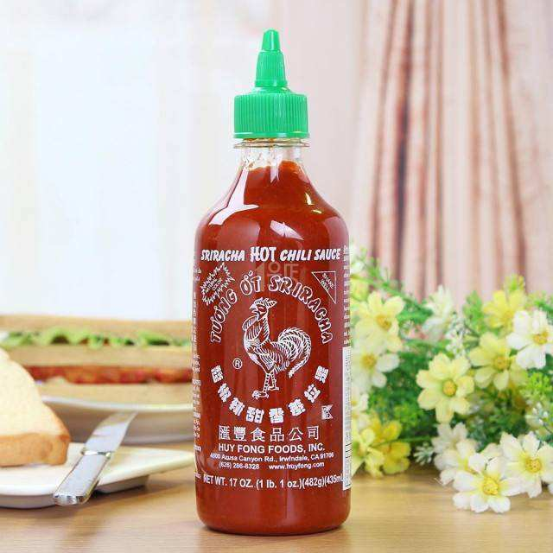
What can we do based on word embedding?
Embedding as semantic properties
Word similarity
Analogy
Embedding as features
Text classification
From word to phrase, sentence and document
Embedding as the initialization of NNs
CNN
RNN
Word2vec is the sriracha sauce of deep learning!

Slide 48
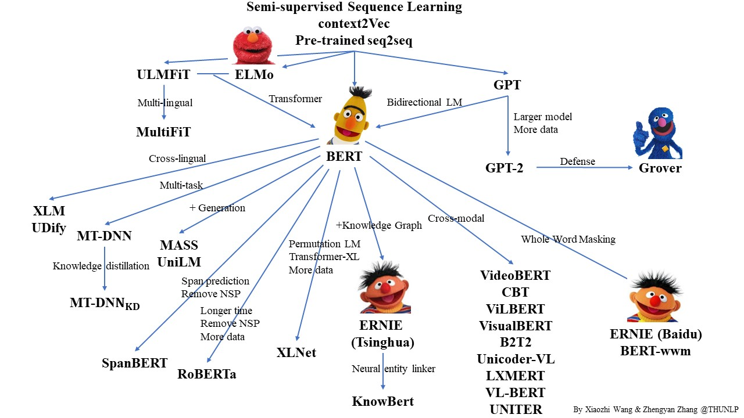
The age of pre-trained language models
Notes:
基线BERT-Large模型需要100万次迭代才能完成预训练
BERT 1024块TPU
XLNet 用了 126GB 的纯文本，TPU 成本要花 6.14 万美元

Slide 49
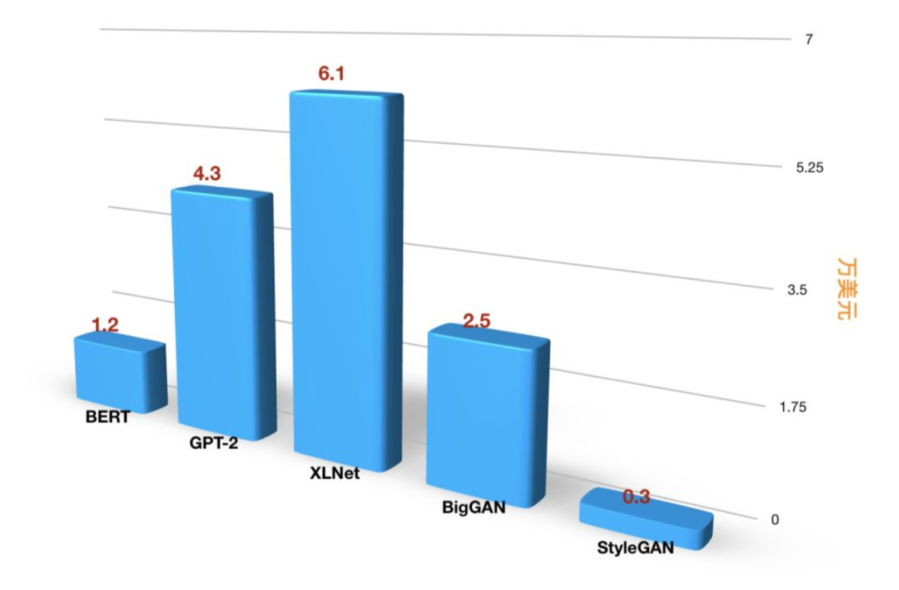
The age of pre-trained language models
图片来源于机器之心
https://www.jiqizhixin.com/articles/2019-06-30-5
Notes:
基线BERT-Large模型需要100万次迭代才能完成预训练
BERT 1024块TPU
XLNet 用了 126GB 的纯文本，TPU 成本要花 6.14 万美元

Slide 50
From word to phrase, sentence and document

Slide 51
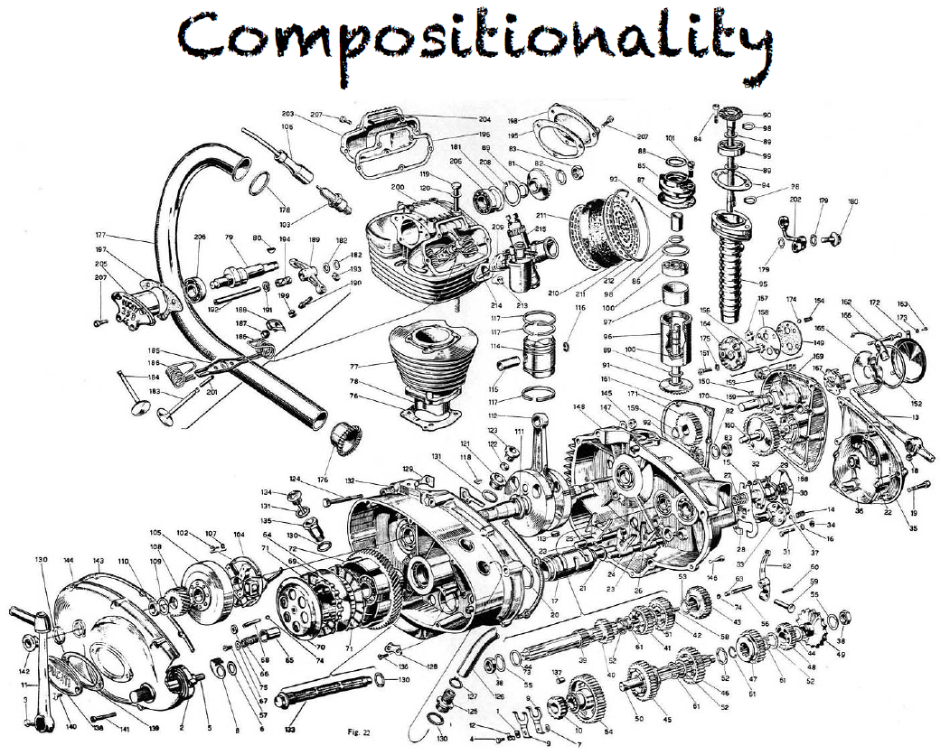
From word to phrase, sentence and document

Slide 52
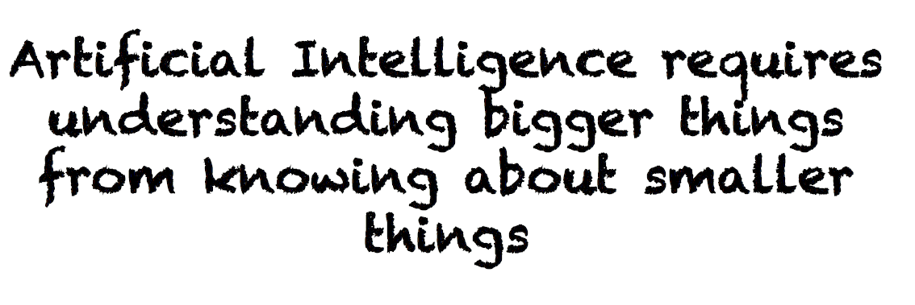
From word to phrase, sentence and document

Slide 53
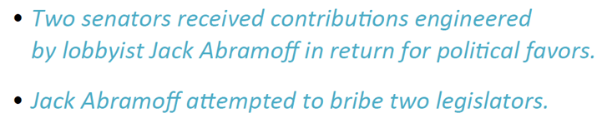
We need more! What of larger semantic units?
How can we know when larger units are similar in meaning?
People interpret the meaning of larger text units-entities, descriptive terms, facts, arguments, stories-by semantic composition of smaller elements

Slide 54
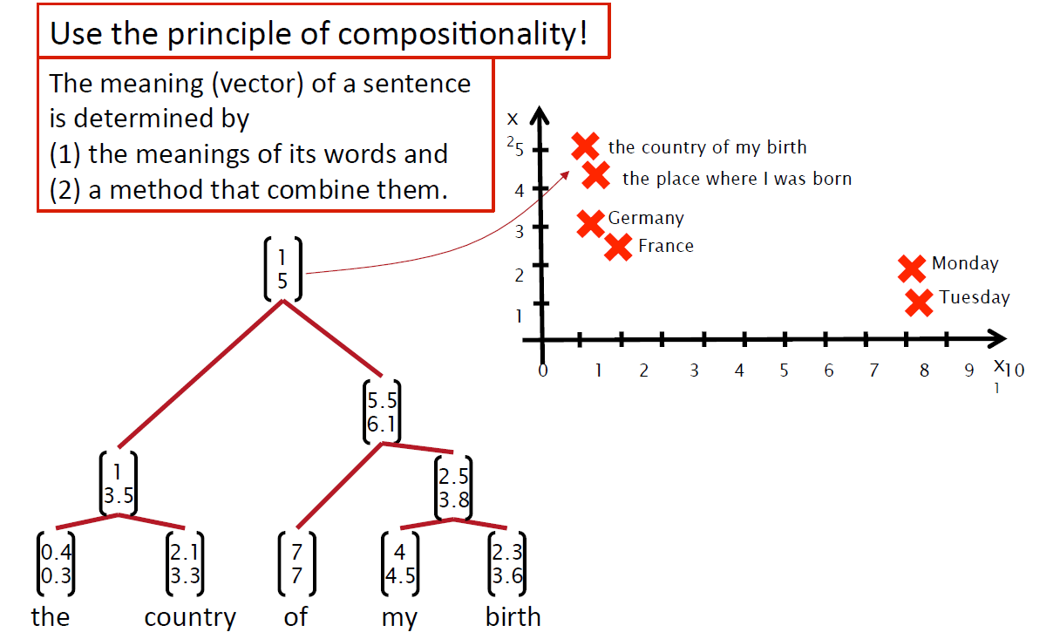
How should we map phrases into a vector space?

Slide 55
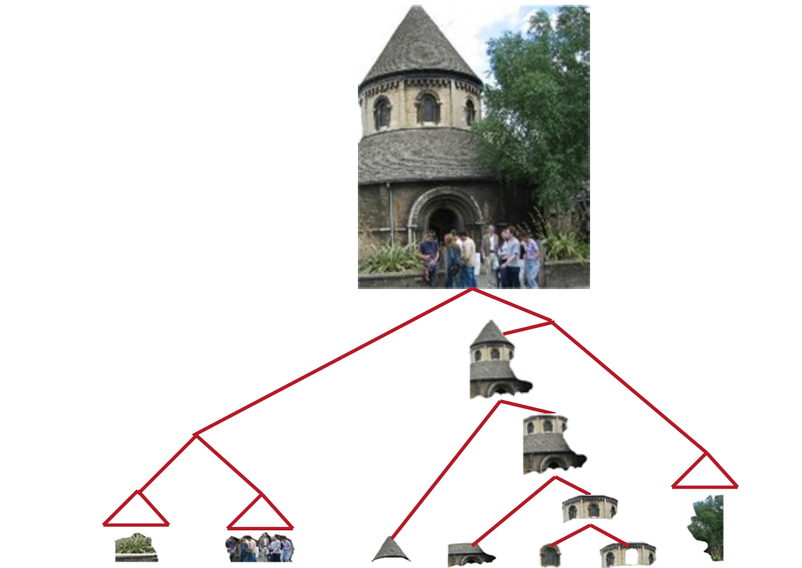
How should we map phrases into a vector space?

Slide 56
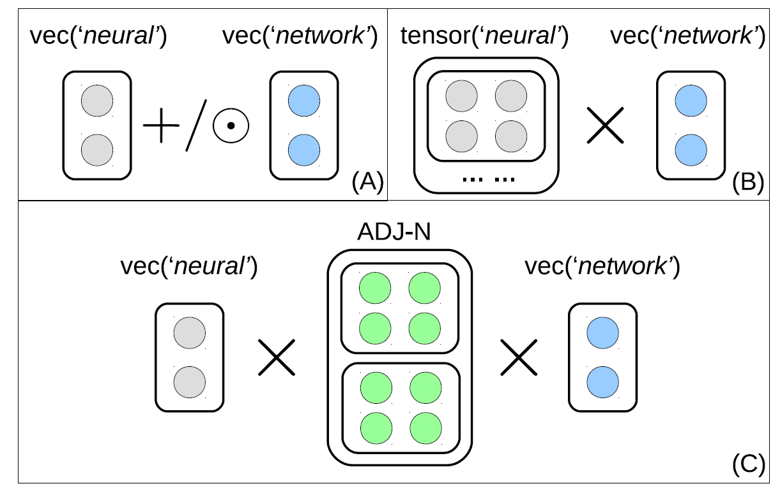
Semantic Compositionality
Phrase Type Sensitive Tensor Indexing Model for Semantic Composition (AAAI 2015)

Slide 57
Embedding Everything!
Word embedding
Phrase embedding
Sentence embedding
Document embedding
Social network embedding
Relation embedding
Image embedding
Video embedding
……

Slide 58
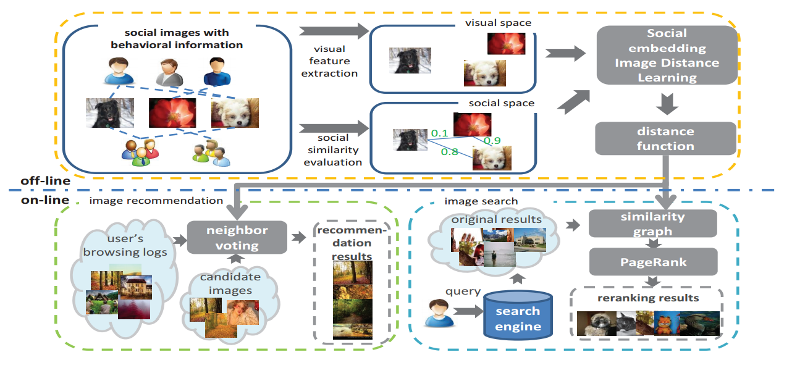
Social and Image Distance Embedding
Social Embedding Image Distance Learning (MM 2014)

Slide 59
Conclusion
Word embedding
Modeling the word into vector space based on deep learning method
Very useful for many further tasks
From word embedding to phrase, sentence, paragraph and document embedding
Compositionality
Embedding everything!
What about social network?

Slide 60

Let’s continue to:
Network Embedding

